Slide 1

TEAM
COLLABORATION
PORTAL

Slide 2

UnityHub

Slide 3


CONTENT
1
INTRODUCTION
2
PROBLEM STATEMENT
3
SOLUTION
4
HARDWARE USED
5
SOFTWARE USED
6
REFERENCES
7
WEBSITE

Slide 4

INTRODUCTION
WE HAVE DEVELOPED A USER-FRIENDLY WEBPAGE THAT HELPS INDIVIDUALS FORM EFFECTIVE PROJECT TEAMS BY CONNECTING THEM WITH LIKE-MINDED PROFESSIONALS AND FACILITATING SEAMLESS COMMUNICATION. OUR PLATFORM INCORPORATES AN EXPERIENCE LEVEL ASSESSMENT, ALLOWING USERS TO JOIN TEAMS THAT ALIGN WITH THEIR SKILL LEVEL. THIS FEATURE BRIDGES THE GAP BETWEEN TALENT AND PROJECT REQUIREMENTS, PROMOTING SUCCESSFUL OUTCOMES

Slide 5

PROBLEM STATEMENT
THE PROBLEM LIES IN THE DIFFICULTY OF FORMING TEAMS AND FINDING SUITABLE TEAMMATES FOR EFFICIENT PROJECT WORK. CURRENT METHODS LACK EFFECTIVE COMMUNICATION AND MATCHING MECHANISMS. OUR SOLUTION IS TO DEVELOP A WEBPAGE THAT ENABLES PEOPLE TO CONNECT, COLLABORATE, AND JOIN TEAMS BASED ON THEIR SKILLS AND EXPERIENCE. THIS ADDRESSES THE PROBLEM BY PROVIDING A STREAMLINED PLATFORM FOR TEAM FORMATION AND ENSURING INDIVIDUALS ARE MATCHED APPROPRIATELY TO MAXIMIZE PROJECT SUCCESS.

Slide 6

SOLUTION STATEMENT
OUR SOLUTION IS A DYNAMIC WEBPAGE THAT FACILITATES EFFECTIVE TEAM FORMATION AND COLLABORATION. BY INTEGRATING COMMUNICATION FEATURES AND ALLOWING INDIVIDUALS TO INDICATE THEIR SKILLS AND EXPERIENCE, OUR PLATFORM ENSURES SUITABLE TEAM MATCHES FOR EFFICIENT PROJECT WORK. IT STREAMLINES THE PROCESS, MAXIMIZING PRODUCTIVITY AND ENABLING INDIVIDUALS TO FIND RELEVANT PROJECTS AND ASSIGNMENTS WITHIN THE TEAM.

Slide 7

REFERENCE
1
TEMPLATES HELP BY- DRIBBBLE, CANVA
2
COLOUR GRADIANT- CSSGRADIENT.IO

Slide 8
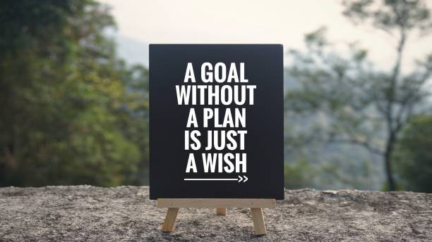
FUTURE
GOALS
To allow the usage of website to larger no. of of audience at a time
Develping the project at higher scale for provision of income by introducing some premium features

Slide 9
THANK YOU !!!

